Slide 1

Chapter 8 The Map ADT

Slide 2
Chapter 8: The Map ADT
8.1 – The Map Interface
8.2 – Map Implementations
8.3 – Application: String-to-String Map
8.4 – Hashing
8.5 – Hash Functions
8.6 – A Hash-Based Map
8.7 – Map Variations

Slide 3
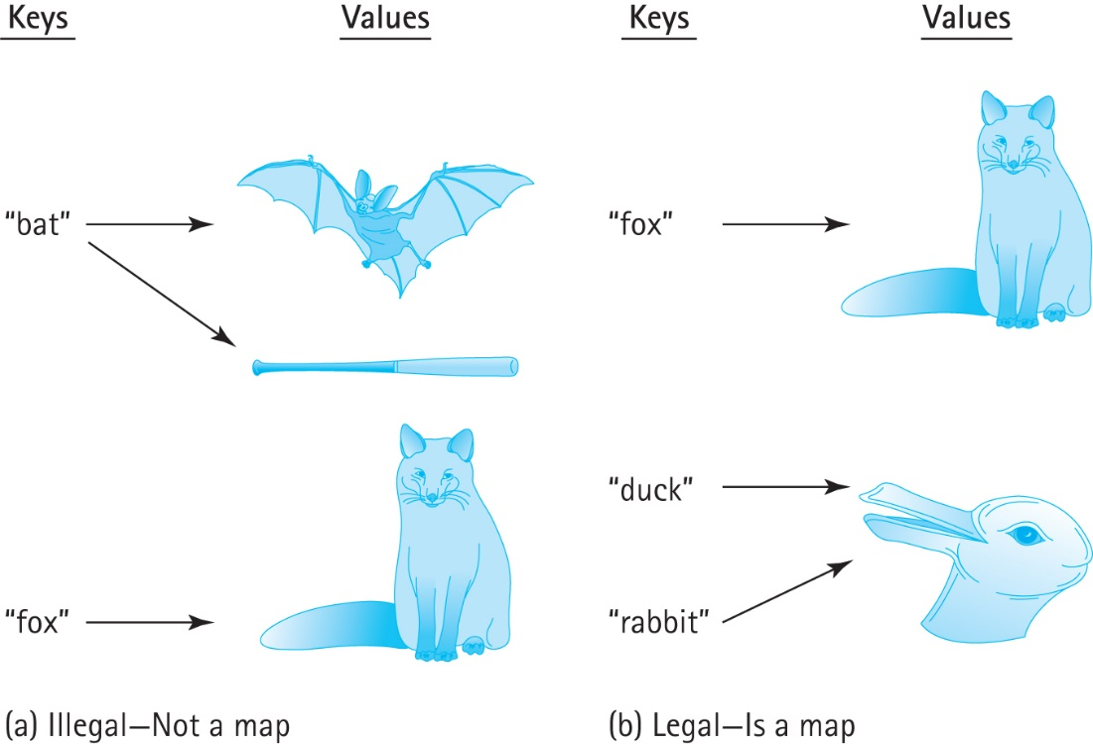
8.1 The Map Interface
Maps associate a key with exactly one value
In other words
a map structure does not permit duplicate keys
but two distinct keys can map onto the same value

Slide 4
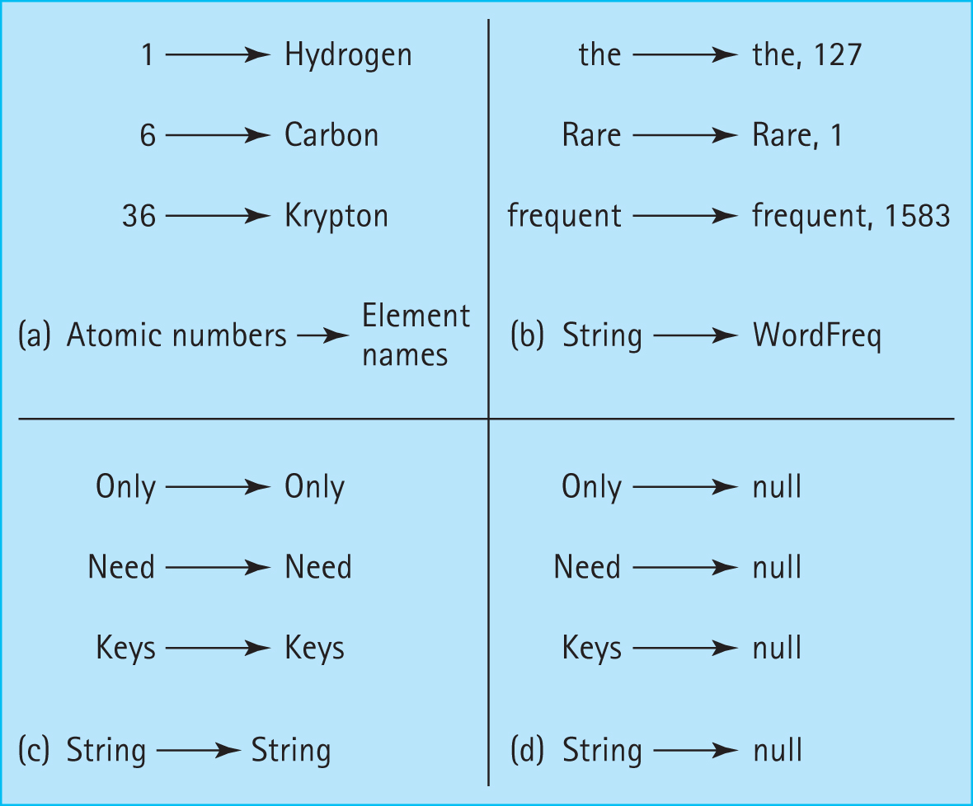
Legal mapping variations

Slide 5
MapInterface
//------------------------------------------------------------------------// MapInterface.java by Dale/Joyce/Weems Chapter 8 //
// A map provides (K = key, V = value) pairs, mapping the key onto
// the value.
// Keys are unique. Keys cannot be null.
//
// Methods throw IllegalArgumentException if passed a null key argument.
//
// Values can be null, so a null value returned by put, get, or remove does
// not necessarily mean that an entry did not exist.
//------------------------------------------------------------------------
//
// . . . continued on next slide

Slide 6
package ch08.maps;
import java.util.Iterator;
public interface MapInterface<K, V> extends Iterable<MapEntry<K,V>>
{
V put(K k, V v);
// If an entry in this map with key k already exists then the value
// associated with that entry is replaced by value v and the original
// value is returned; otherwise, adds the (k, v) pair to the map and
// returns null.
V get(K k);
// If an entry in this map with a key k exists then the value associated
// with that entry is returned; otherwise null is returned.
V remove(K k);
// If an entry in this map with key k exists then the entry is removed
// from the map and the value associated with that entry is returned;
// otherwise null is returned.
//
// Optional. Throws UnsupportedOperationException if not supported.
// Also requires contains(K key), isFull(), isEmpty() and size()
}

Slide 7
Iteration
We require an iteration that returns key-value pairs
The class MapEntry represents the key-value pairs
requires the key and value to be passed as constructor arguments
provides getter operations for both key and value
provides a setter operation for the value
provides a toString

Slide 8
MapExample
Instructors can now discuss and demonstrate the MapExample application found in the ch08.apps package … it uses the ArrayListMap class presented in the next section

Slide 9
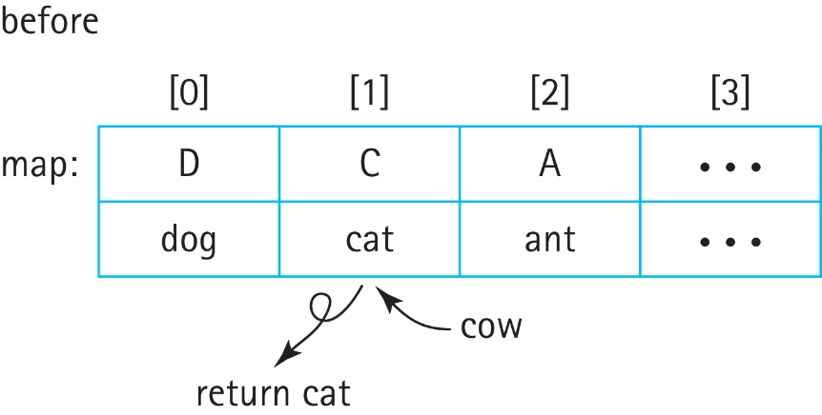
8.2 Map Implementations
Unsorted Array
The put operation creates a new MapEntry object and performs a brute force search (O(N)) of all the current keys in the array to prevent key duplication
If a duplicate key is found, then the associated MapEntry object is replaced by the new object and its value attribute is returned, for example map.put(cow)

Slide 10
Map Implementations
Unsorted Array
Like put, the get, remove, and contains operations would all require brute force searches of the current array contents, so they are all O(N)
Sorted Array
The binary search algorithm can be used, greatly improving the efficiency of the important get and contains operations.
Although it is not a requirement, in general it is expected that a map will provide fast implementation of these two operations.

Slide 11
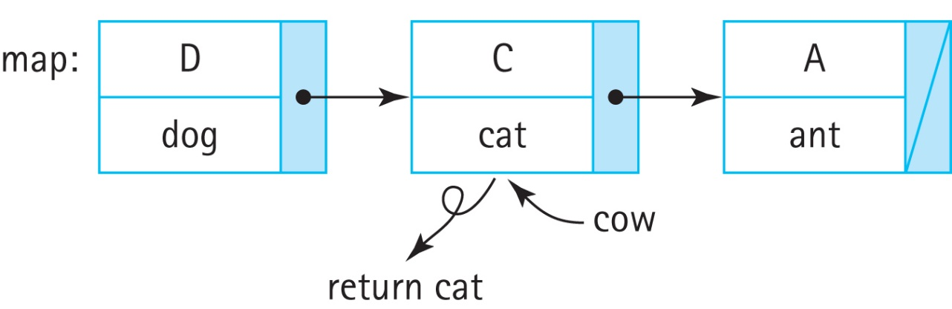
Map Implementations
Unsorted Linked List
Similar to an unsorted array, most operations require brute force search
In terms of space, a linked list grows and shrinks as needed so it is possible that some advantage can be found in terms of memory management, as compared to an array.

Slide 12
Map Implementations
Sorted Linked List
Even though a linked list is kept sorted, it does not permit use of the binary search algorithm as there is no efficient way to inspect the “middle” element.
So there is not much advantage to using a sorted linked list to implement a map, as compared to an unsorted linked list

Slide 13
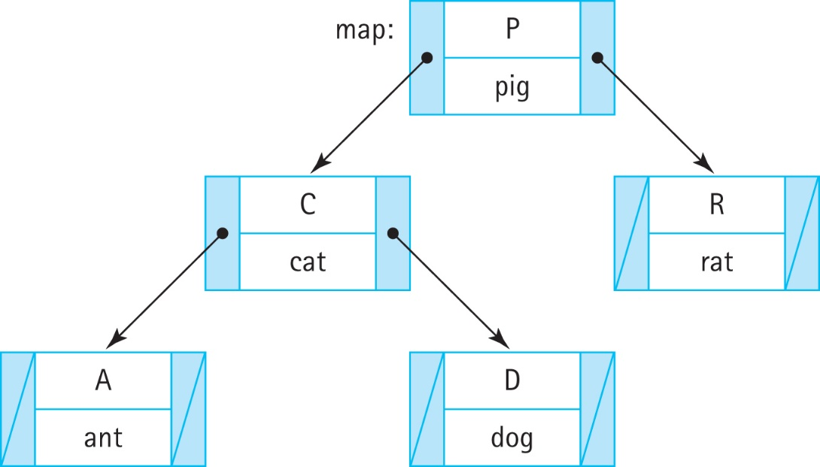
Map Implementations
Binary Search Tree
If a map can be implemented as a balanced binary search tree, then all of the primary operations (put, get, remove, and contains) can exhibit efficiency O(log₂N).

Slide 14
ArrayListMap
Instructors can now discuss the ArrayListMap class found in the ch08.maps package and review the associated notes found on pages 511 and 512

Slide 15
8.3 Application: String-to-String Map
The StringPairApp found in the ch08.apps package reads # separated pairs of strings (key # value) from specified input file and then allows the user to enter keys and reports back to them the associated value if there is one.
It is a short yet versatile application that demonstrates the use of our Map ADT

Slide 16
8.4 Hashing
An efficient approach to implementing a Map
Typically provides O(1) operation implementation
Uses an array (typically called a hash table) to hold the key/value pairs
Hashing involves determining array indices directly from the key of the entry being stored/accessed.

Slide 17
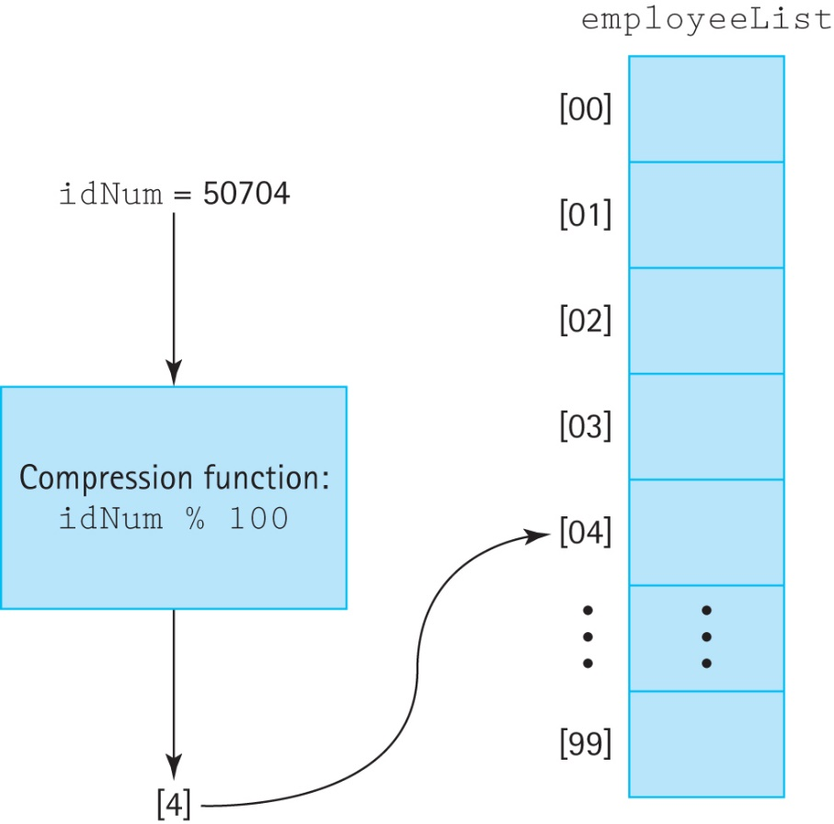
Compression function
If we have a positive integral key, such as an ID number, we can just use the key as the index into the array
If the range of key values is larger than the array we must “compress” the key into a usable index

Slide 18
Collisions
If two keys compress to the same array location we call it a “collision”
minimizing such collisions is the biggest challenge in designing a good hashing system
we cover this in Section 8.5, “Hash Functions.”
In our discussion of collision resolution policies, we will assume
use of an array info to hold the information
the int variable location to indicate an array/hash-table slot.

Slide 19
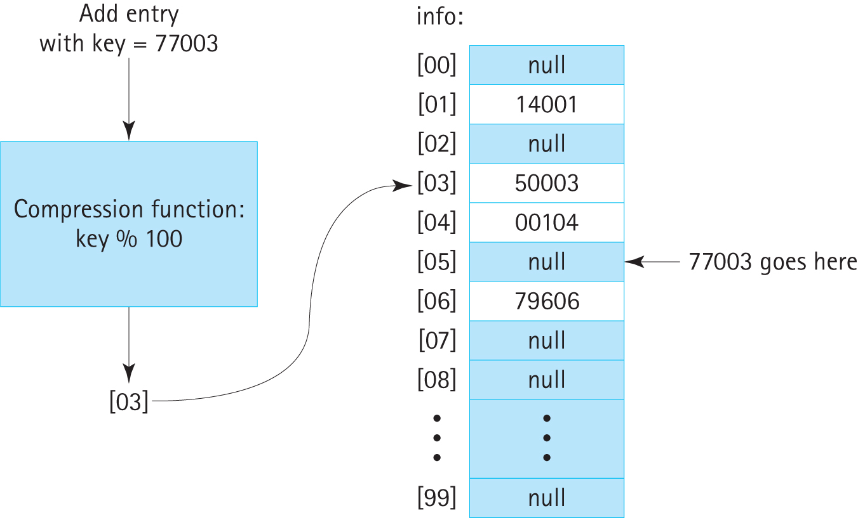
Collision resolution policies
Linear probing: store the colliding entry into the next available space:

Slide 20
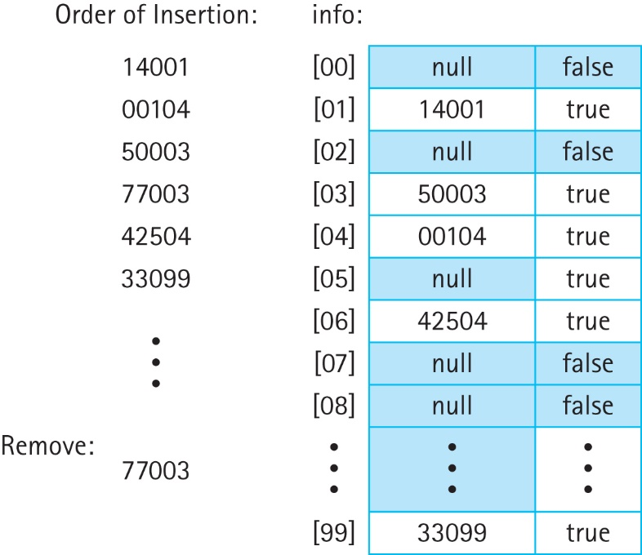
Item Removal
Complicates searching: can not terminate search upon finding a null entry therefore:
use a special value for a removed entry
use a boolean value associated with each hash table slot:
disallow removal

Slide 21
Collision resolution policies
Linear probing approach can lead to inefficient clusters of entries
Quadratic probing: the value added at each step is dependent on how many locations have already been inspected.
The first time it looks for a new location it adds 1 to the original location
the second time it adds 4 to the original location
the third time it adds 9 to the original location
and so on—the i^{th} time it adds i²:

Slide 22
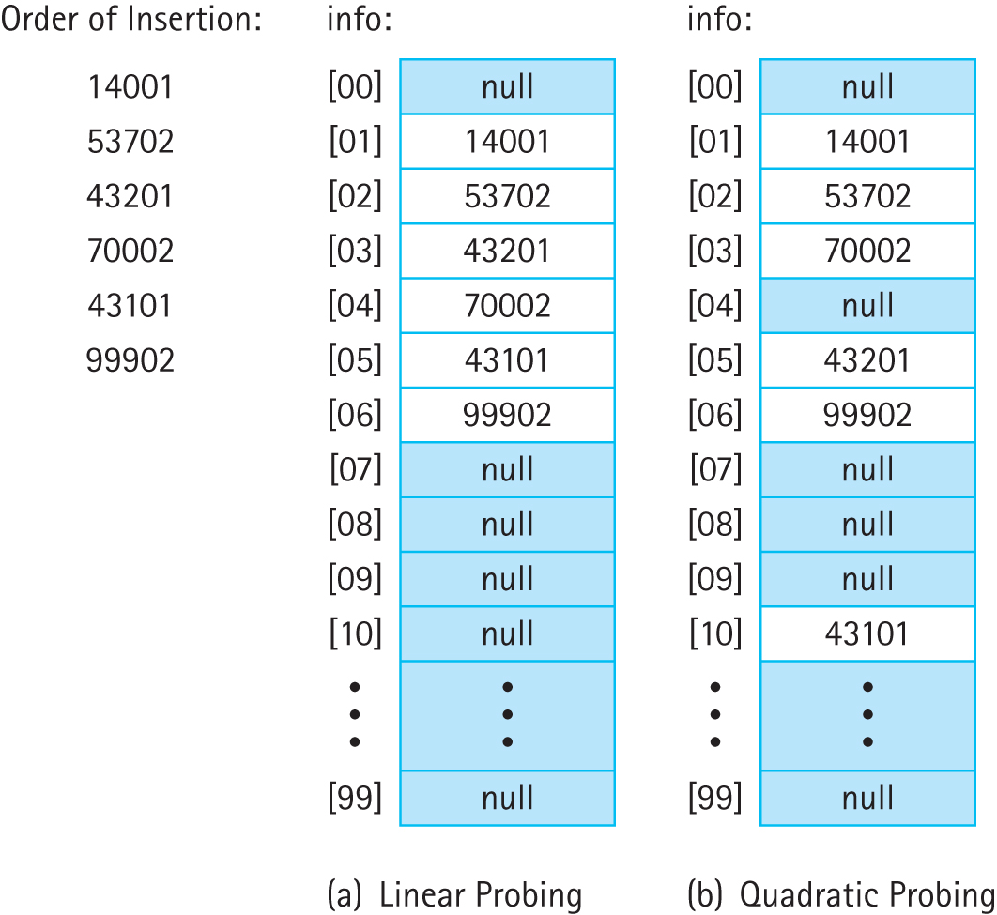
Comparison

Slide 23
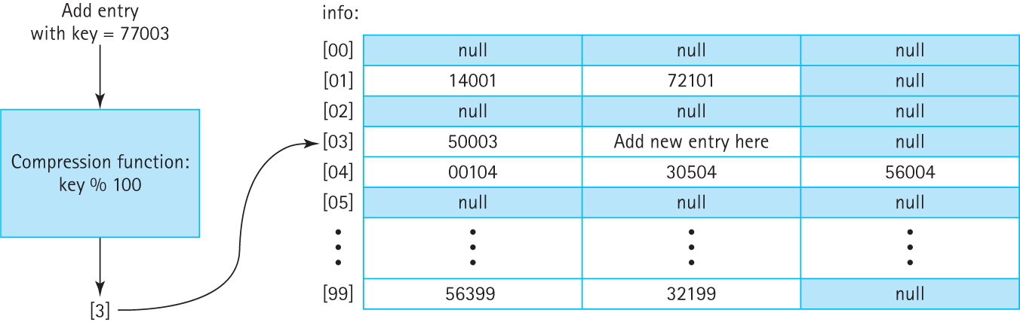
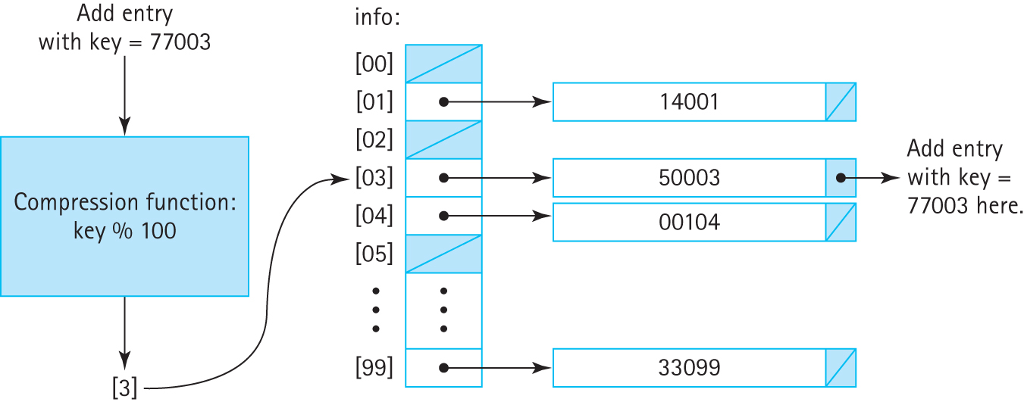
Collision resolution policies Buckets and Chaining

Slide 24
8.5 Hash Functions
To get the most benefit from a hashing system we need for the eventual locations used in the underlying array to be as spread out as possible.
Two factors affect this spread
the size of the underlying array
the set of integral values presented to the compression function

Slide 25
Array Size
space versus time trade-off
hash systems will often monitor their own load—the percentage of array indices being used
Once the load reaches a certain level, for example 75%, the system is rebuilt using a larger array
This approach is often called “rehashing” because after the array is enlarged all of the previous entries have to be reinserted into the new array

Slide 26
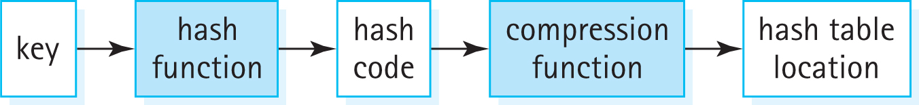
The Hash Function
Keys might not be integral
Even if integral, keys might not provide a good “spread”
So, we add another step, the hash function:
Synonyms for “hash code” include “hash value,” and sometimes we just use the word “hash.”

Slide 27
Creating a hash function
Selecting: Identify selected parts of the key – try to use parts that will provide a good variety of results
Digitizing: the selected parts must be transformed to integers
Combining: combine the resultant integers using a mathematical function

Slide 28
Considerations
A hash code is not unique. Do not use a hash code as a key.
If two entries are considered to be equal, then they should hash to the same value.
When defining a hash function, consider the work required to calculate it.
A precise analysis of the complexity of hashing depends on the domain and distribution of keys, the hash function, the size of the table, and the collision resolution policy. In practice it is usually not difficult to achieve close to O(1) efficiency using hashing.

Slide 29
Java’s Support for Hashing
The Java Library includes a HashMap class (discussed in Section 8.7) and a HashSet class that use hash techniques to support storing objects
The Java Object class exports a hashCode method that returns an int hash code.
The standard Java hash code for an object is a function of the object’s memory location.
For most applications, hash codes based on memory locations are not usable. Many of the Java classes that define commonly used objects (such as String and Integer), override the Object class’s hashCode method.
If you plan to use hash tables in your programs, you should do likewise.

Slide 30
8.6 A Hash-Based Map Hmap.java
is implemented with an internal hash table that uses the hashCode method of the key class
is unbounded
has a default capacity of 1,000 and a default load factor of 75%
does not support the remove operation
is located in the ch08.maps package
is used by the VocDensMeasureHMap application located in the ch08.apps package

Slide 31
8.7 Map Variations
Some programming languages, (e.g., Awk, Haskell, JavaScript, Lisp, MUMPS, Perl, PHP, Python, and Ruby), directly support
Many other languages, including Java, C++, Objective-C, and Smalltalk provide map functionality through their standard code libraries

Slide 32
Maps are known by many names:
Symbol table - one of the first carefully studied and designed data structures, and were related to compiler design
Dictionary - the idea of looking up a word (the key) in a dictionary to find its definition (the value) makes the concept of a dictionary a good fit for maps
Hashes - because a hash system is a very efficient and common way to implement a map, you will sometimes see the two terms used interchangeably
Associative Arrays - You can view a map as an array—one that associates keys with values rather than indices with values.

